Slide 1
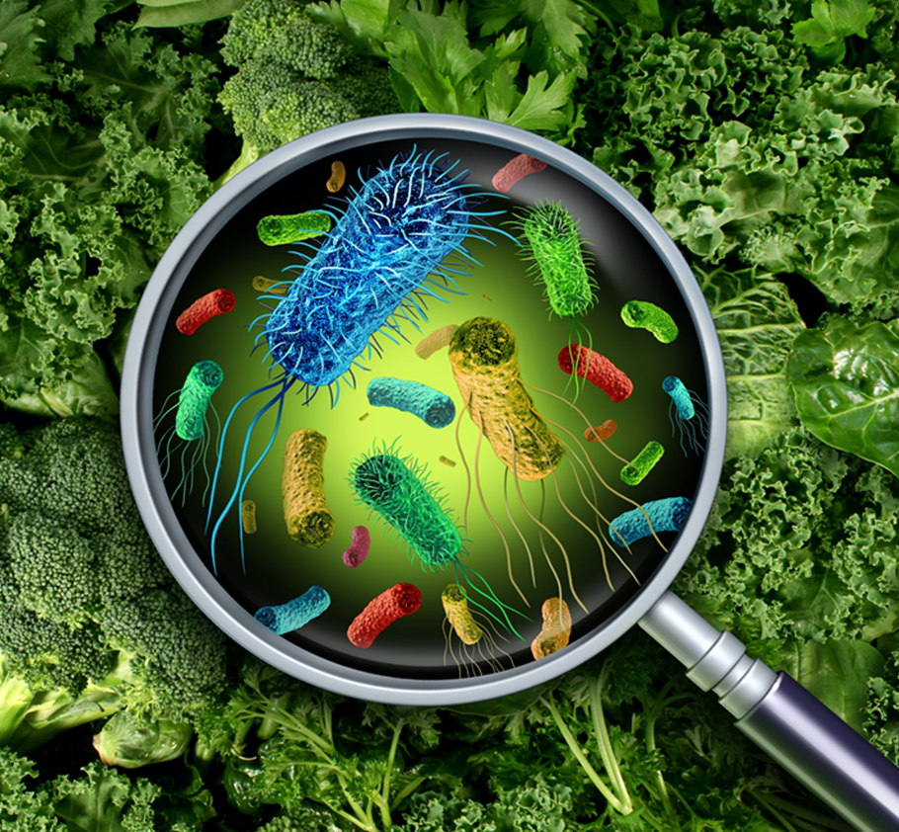
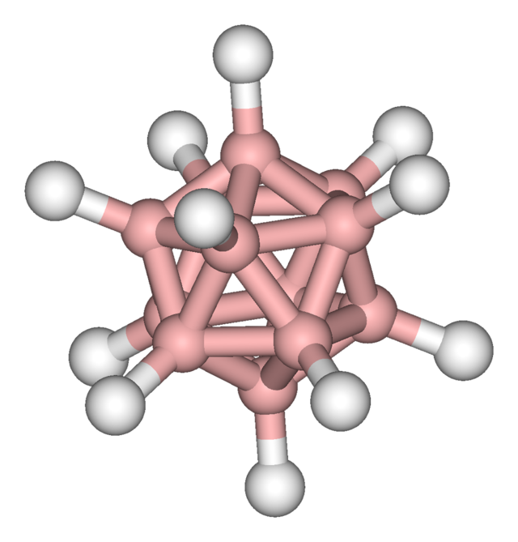

Slide 2
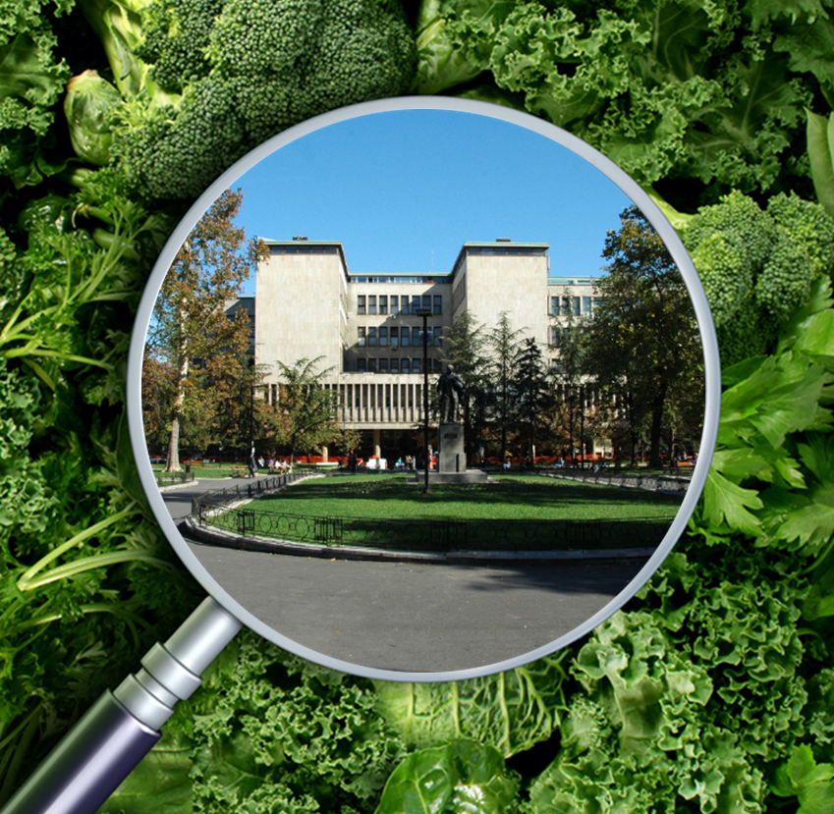

Slide 3
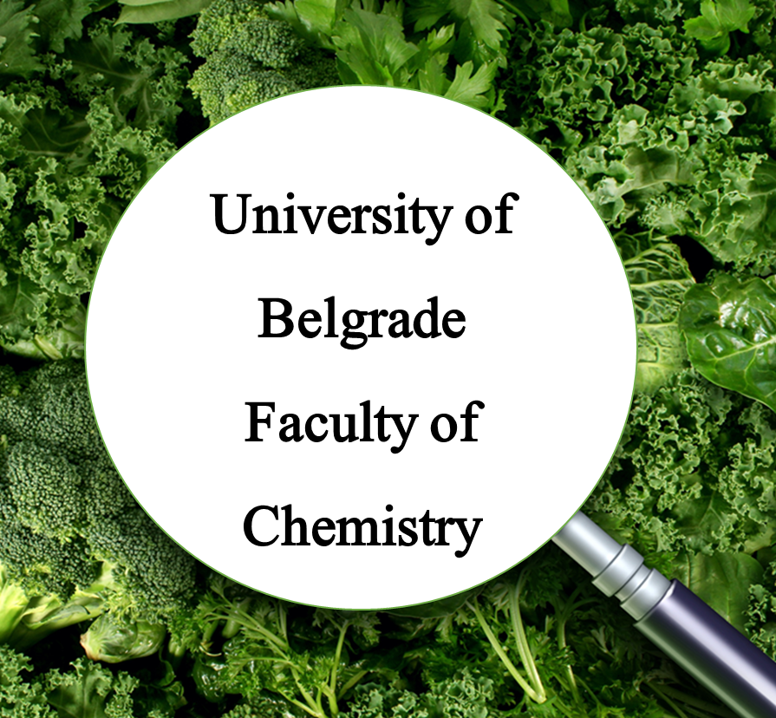
University of Belgrade
Faculty of Chemistry

Slide 4

THE UNIVERSITY OF BELGRADE’S FACULTY OF CHEMISTRY (UBFC) is one of 31 faculties that form the UB and is an internationally respected center for high-quality scientific research, with the aim to maintain outstanding reputation and to meet the challenges of the 21st century.
University of Belgrade is a leading higher education and research institution in the Western Balkans, located in an EU Associated country, with good prospects of increasing its competitiveness at the European and global level.

Slide 5
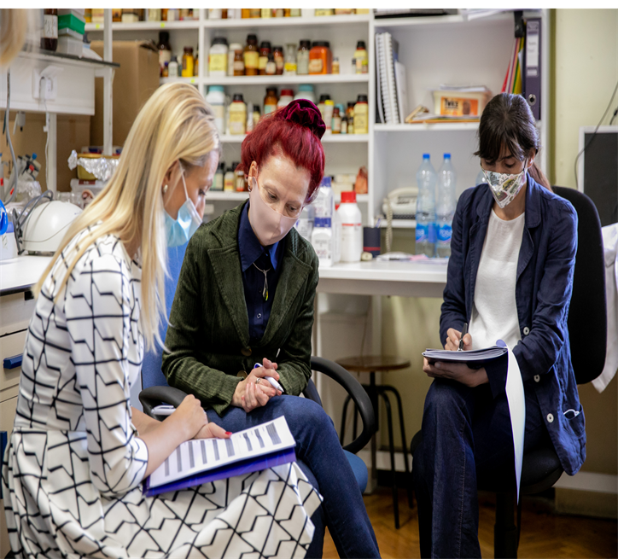

Slide 6
CENTER OF RESEARCH EXCELLENCE
UBFC represents a nationally accredited Center of research excellence for molecular food sciences, widelly recognized for its expertise in:
Advanced analytical chemistry;
Omics technologies in food & environmental sciences - proteomics, metabolomics, metallomics, lipidomics;
Microplastics characterization;
food authenticity, food adulteration.
UBFC harbours the University of Belgrade's core facility for instrumental analysis, with cutting edge equipment, including NMR spectroscopy, mass spectrometry (HRMS, GCMS, GS/GS MS, IRMS, ICP-MS), microplastics and trace elemental analysis open for external users.

Slide 7
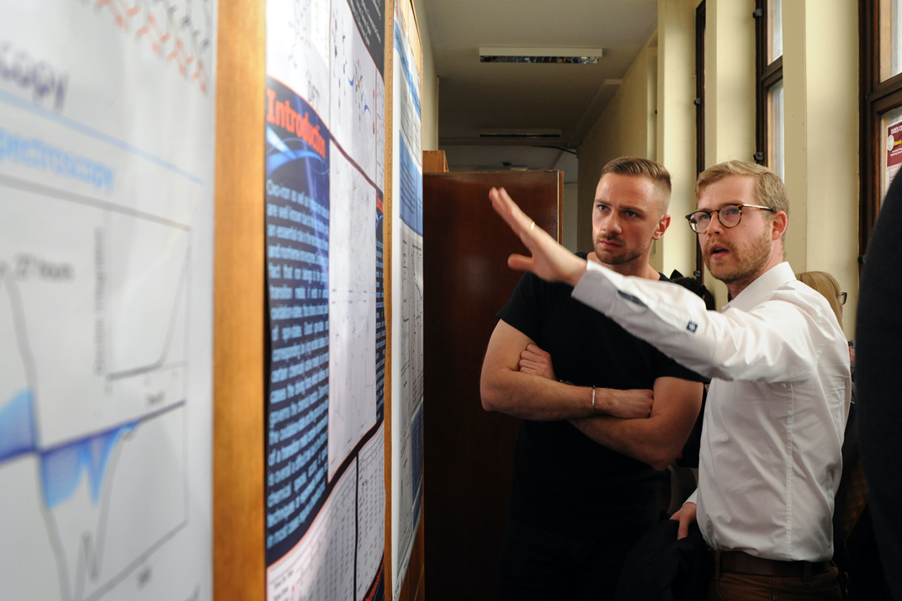

Slide 8

HANDS-ON CONCEPT, from sample preparation to data analysis and reporting
Individual practical TRAINING FOR INSTRUMENTAL ANALYSIS on NMR, HRMS, GCMS, microFTIR with the focus on applications in food, nutrition and environmental analysis;
SAMPLE ANALYSIS AND INTERPRETATION OF RESULTS
CONSULATANCY IN ‘OMICS
In addition to education at BSc, MSc and PhD levels, UBFC has experience in organization of international practical schools and short term training seminars tailored for small groups of researchers and research professionals.

Slide 9
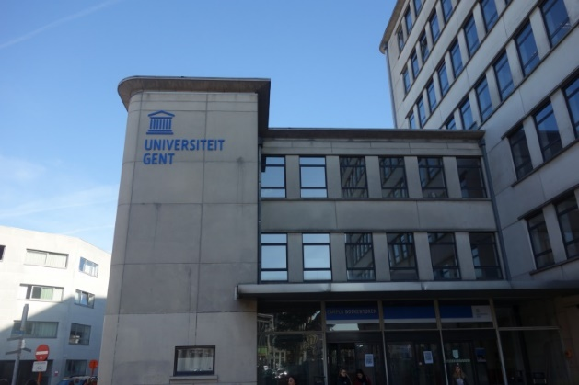
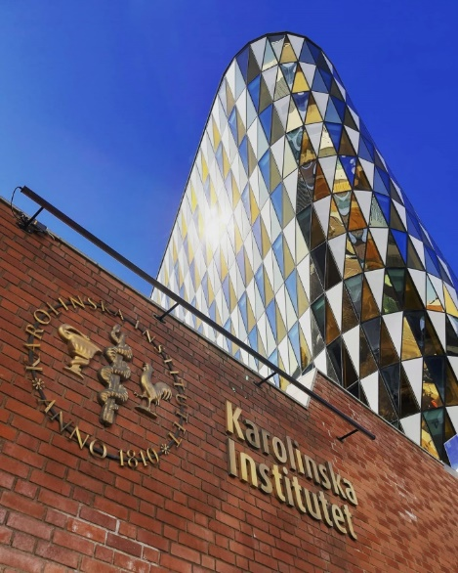



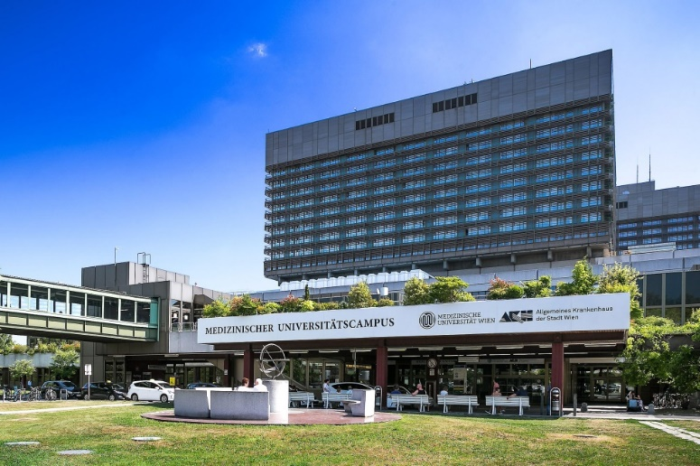


TWINNING WITH TOP LEVEL EU INSTITUTIONS

Slide 10
METALLOMICS IN FOOD AND ENVIRONMENT
If you are a PhD student, a post-doctoral scientist, or a junior researcher, attracted to the world of metallomics, and want to know more about analytical methodologies or emerging applications in the area of metallomics, than our Metalomics School is just the right place to attend.
Our summer school offers you a large variety of lectures on fundamental research and specific topics.
It will also give you the opportunity to take part in practical sessions focusing on analytical techniques frequently used in metallomics applications.
Metallomics summer school includes an overview of theoretical concepts and experimental approaches in metallomics, as well as future challenges in the field.

Slide 11
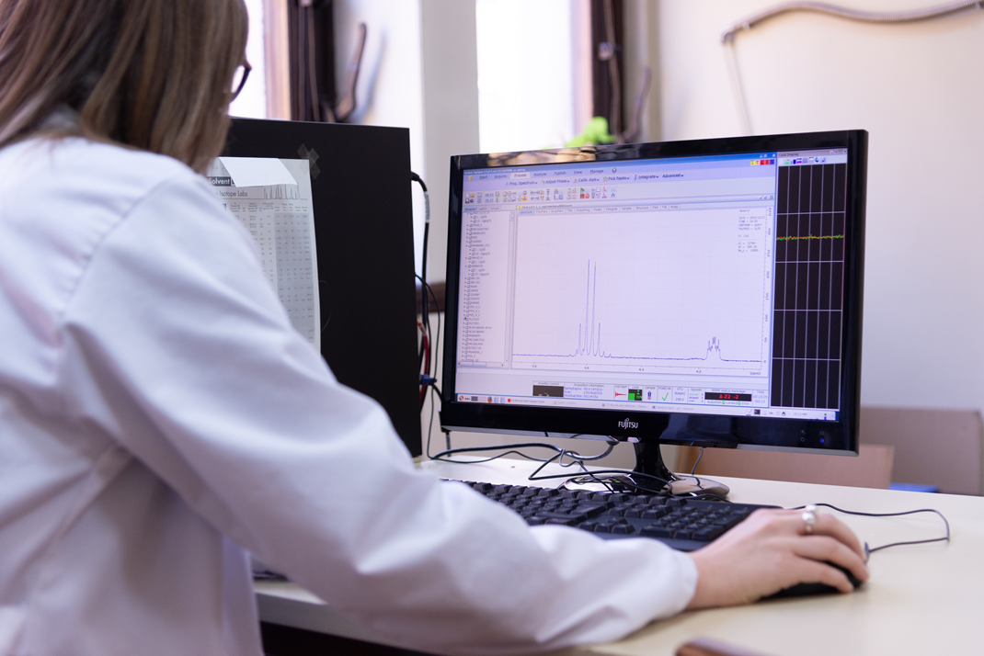
Essential, non – essential and toxic elements
Sample treatment, separation, detection approaches (ICP OES and ICP MS)
Statistical analysis
Analytical concepts
Computer-assisted theoretical modeling
Previous edition in 2019 has been attended by more than 40 PhD students and researchers.
Instrumentation: ICP-OES, ICP-MS
PROGRAM AT A GLANCE
foodentwin@chem.bg.ac.rs

Slide 12
PROTEOMICS:
PRACTICAL ASPECTS
Dedicated to PhD students, post-doctoral scientists, or junior researchers, who aim to gain basic training in proteomics.
An excellent opportunity for researchers from different fields to learn and share information on research, theories and especially practical aspects of proteomics.
A space to exchange ideas and knowledge, and enable communication, networking and international collaborations.
Opportunity to acquire new knowledge and practical skills in proteomics, discuss problems,

Slide 13
Sample preparation
2D PAGE, shotgun analysis
Mass spectrometry analysis
Data analysis (PEAKS X PRO)
Available instrumentation: Thermo Scientific Orbitrap Exploris 240 with UltiMate 3000 RSLCnano system
Previous editions in 2015 and 2020 have been attended by more than 150 PhD students and researchers
PROTEOMICS SCHOOL PROGRAM AT A GLANCE:
foodentwin@chem.bg.ac.rs

Slide 14
LIPIDOMICS: FOOD AND FEED APPLICATIONS
For a PhD student, a post-doctoral scientist, or a junior researcher, attracted to the world of lipidomics,
For researchers who want to learn more about analytical methodologies or emerging applications in the area of lipidomics
a large variety of interesting lectures on fundamental research and specific topics
practical sessions focusing on analytical techniques frequently used in lipidomics applications.

Slide 15
LIPIDOMIC FOOD AND ENVIRONMENTAL APPLICATIONS PROGRAM AT A GLANCE
An overview of theoretical concepts and experimental approaches in lipidomics, future challenges.
Sample treatment
Profiling fatty acids by gas chromatographic analysis
Profiling sterols by gas chromatographic analysis coupled to mass spectrometry
Characterization of the lipidome via high resolution mass spectroscopy
Instrumentation: GC/MS, GC/GC/MS, Thermo Scientific LTQ Orbitrap XL with Accela UHPLC System
foodentwin@chem.bg.ac.rs

Slide 16

GET TO KNOW MICROPLASTICS SCHOOL
learn more about emerging food and environmental contaminants
a large variety of interesting lectures on fundamental research and specific topics presented by established scientists in their respective fields.
An opportunity to take part in practical sessions focusing on contemporary analytical techniques used in microplastics research.

Slide 17
MICROPLASTICS SCHOOL PROGRAM AT A GLANCE:
An overview on microplastics definition, occurence, available methodologies for microplastics isolation and characterization.
Sample treatment
Isolation of microplastics from simple and complex matrices
Particle counting by fluorescence microscopy
Chemical characterization of microplastics by microFTIR
Instrumentation: Thermo Scientific Nicolet iN10 microFTIR
foodentwin@chem.bg.ac.rs

Slide 18
METABOLOMICS TRAINING SCHOOL
Dedicated to PhD students, post-doctoral scientists, or junior researchers, who aim to gain training in metabolomics.
Learning outcomes-based training course:
basics of multivariate data analysis in metabolomics,
various analytical platforms (chromatography, mass spectrometry FTIR and NMR) used for metabolomics;
perform sampling and sample preparation for analysis;
create methods for MS, IR and NMR analytical platforms and
run analysis, processing data in various software (OMNIC, CHEMSTATION, TOPSPIN, COMPASS, MESTRENOVA)
use SIMCA for creating multivariate models (PCA, OPLS, OPLS-DA).
foodentwin@chem.bg.ac.rs

Slide 19
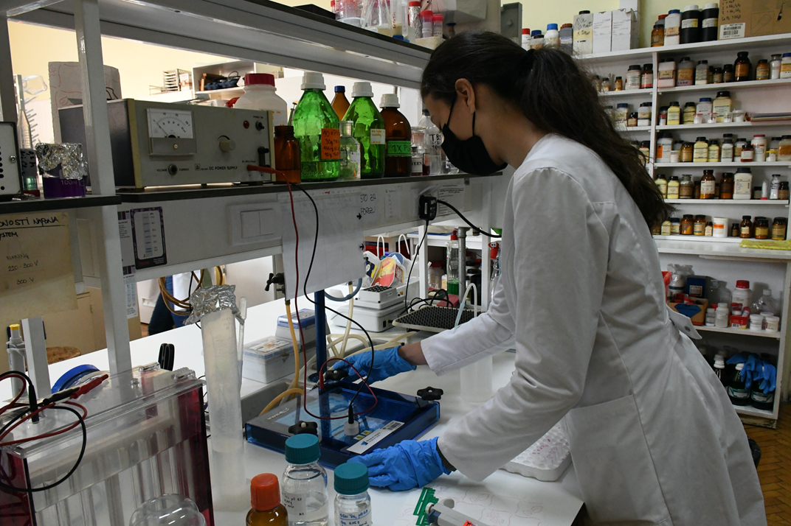
METABOLOMICS TRAINING SCHOOL
Lectures and hands-on experiments covering all aspects of metabolomics as multidisciplinary science:
Metabolomics in food, environmental and medicinal profiling
Sample preparation in metabolomics
IR, GC/MS, LC/MS, NMR analysis and instrumentation
Data analysis and processing for multivariate analysis
Machine learning
Case studies

Slide 20
METABOLOMICS TRAINING SCHOOL PROGRAM AT A GLANCE
Case studies
Fruits profiling by Solid Phase Microextraction (SPME) GC-MS metabolomics,
Propolis profiling by FTIR metabolomics,
Chemical incident detection through plant biosensing by GC/MS and NMR metabolomics,
Diagnostic of Schizophrenia and Bipolar Disorder by NMR-based Metabolomics.
Available instrumentation: Bruker (AVANCE III) NMR 500 MHz, Bruker MicroToF II LC/MS system, Agilent GC/MS system with CTC PAL II Sample preparation platform, Thermo Scientific Nicolet Summit FTIR

Slide 21
CHEMICAL FORENSICS TRAINING SCHOOL
Dedicated to PhD students, post-doctoral scientists, or junior researchers, who aim to gain training in chemical forensics and identification of substances of adulteration (SoA).
CASE STUDIES:
Fake herbal capsules for the Treatment of Erectile Dysfunction (SoA:Tadalafil and Sildenafil)
Green Coffee for Slimming (SoA: Sibutramine)
Fake herbal-based soft gelatin capsule capsules for slimming (SoA: Fluoxetine)
Dangerous designer drug in an ‘Air freshener’ (SoA: AB-Fubinaca)
LEARNING OUTCOMES:
Understand the goal of various spectroscopic methods as cutting-edge tools for food safety,
the weakness of global legislative for food supplements,
sampling and sample preparation,
create spectroscopic methods (MS, IR and NMR) from the scratch
run analysis in various software
structure elucidation
Students will be trained to create reports valid on court.

Slide 22
CHEMICAL FORENCICS TRAINING PROGRAM AT A GLANCE
Unbroken chain of custody
Sample preparation for different analytical platforms
FTIR, GC/MS, LC/MS and 1D and 2D NMR data collection and processing
Structure elucidation of SoA’s
Case studies
How to report presence of SoA to be valid on court
Available instrumentation: Bruker (AVANCE III) NMR 500 MHz, Bruker MicroToF II LC/MS system, Agilent GC/MS system with CTC PAL II Sample preparation platform, Thermo Scientific Nicolet Summit FTIR
foodentwin@chem.bg.ac.rs

Slide 23
Food authenticity training school
Dedicated to PhD students, post-doctoral scientists, or junior researchers, who aim to gain training in food authenticity testing
Lectures and hands-on experiments covering all aspects of food authenticity testing
Case studies
University of Belgrade - Faculty of Chemistry, together with InovaLab – accredited laboratory of the Innovative Centre of the Faculty of Chemistry, Belgrade, Ltd., are recognized as the leading Serbian laboratory for food authenticity testing.
foodentwin@chem.bg.ac.rs

Slide 24
FOOD AUTHENTICITY PROGRAM AT A GLANCE
Sample preparation
Analysis for the stable isotope ratio
Univariate and multivariate chemometric analysis of data
Reporting
Case studies:
Authenticity testing of wine
Authenticity testing of honey
Available instrumentation: Thermo Scientific Delta V advantage IRMS foodentwinw@chem.bg.ac.rs

Slide 25
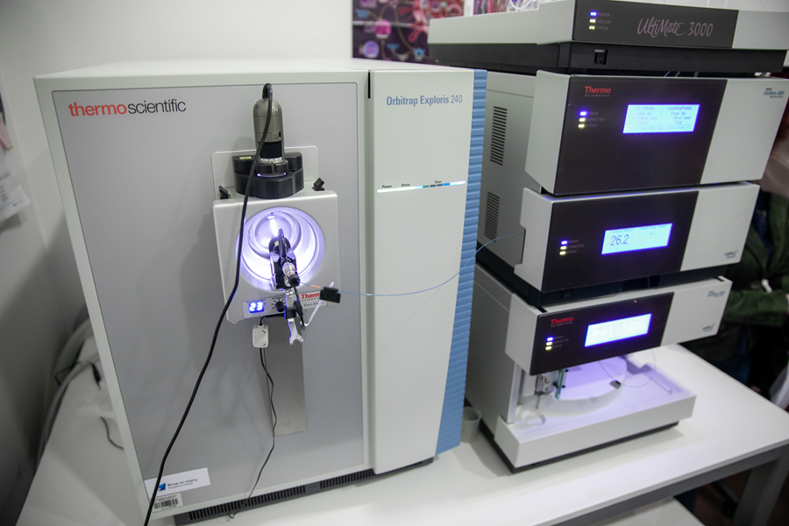
INDIVIDUAL PRACTICAL TRAINING FOR INSTRUMENTAL ANALYSIS
Nuclear magnetic resonance (Bruker (AVANCE III) 500 MHz)
High resolution mass spectrometry (Thermo Scientific Orbitrap Exploris 240, Thermo Scientific LTQ Orbitrap XL, Bruker MicroToF II LC/MS system)
Infrared spectroscopy (Thermo Scientific Nicolet Summit FTIR, Thermo Scientific Nicolet iN10 microFTIR)
Circular dichroism (Jasco J-815 CD)
Gas chromatography (Agilent GC/MS system with CTC PAL II Sample preparation platform, GC/GC/MS)
Inductively Coupled Plasma (Thermo Scientific iCAP Q ICP MS and Thermo Scientific iCAP 6500 Duo ICP OES)
SAMPLE ANALYSIS FOR EXTERNAL USERS: www.chem.bg.ac.rs/analize
foodentwin@chem.bg.ac.rs

Slide 26
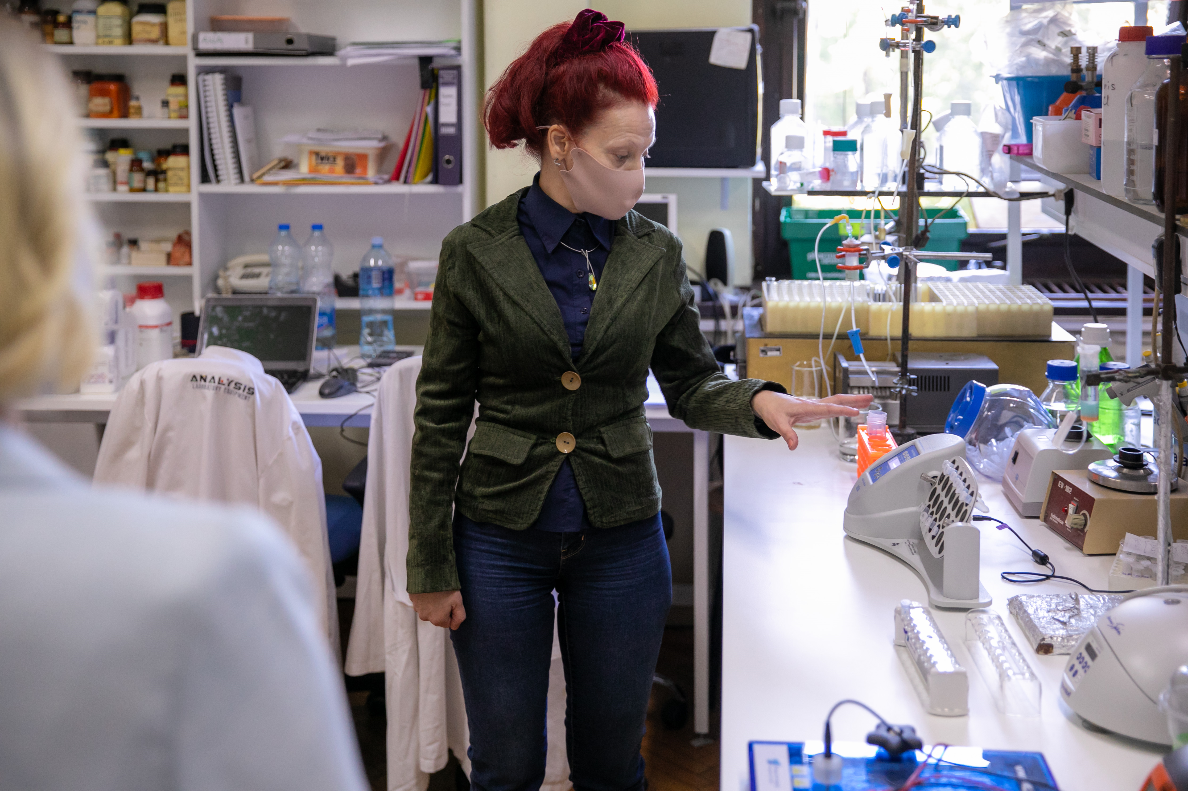

NEXT EDITIONS
Proteomics: practical aspects
August 2022, 10-15.
Metalomics in food and environment
March 2022, 21-25
Lipidomics: food and environmental applications
July 2022, 20-25
Get to know microplastics
November 2022, 14-18
Metabolomics
February 2023, 18-23
Chemical forensics
July 2022, 18-28
Food authenticity
July 2022, 17-22
nauka@chem.bg.ac.rs
foodentwin@chem.bg.ac.rs

Slide 27









Center of research Excellence for molecular food sciences
Inovalab ISO 17025 accreditation for wine and honey authenticity testing
http://chem.bg.ac.rs/index-en.html
nauka@chem.bg.ac.rs
@hemijskifakultet
https://www.facebook.com/hemijskifakultetbg
Design by Miodrag Tabački
Published by Faculty of Chemistry

Slide 28


